Slide 1
VOICE CONTROLLED AUTONOMOUS VEHICLE

Slide 2
INTRODUCTION
Early 21st centuary hurled the people in the middle of transition era-the era of digitalization.This era is termed as “Industry 4.0”.”Industry 4.0” in simple terms is a step ahead in the fields of wireless connectivity,cloud computing,Internet of Things,Cyber-Physical Things, Artifical Intelligence etc.
IoT has made it possible the existence of autonomous vechicle or smart vechicles.We are here to present one such autonomous vechicle which follows the voice instructions through the speech recognizer in MIT App inventer which is present on the users phone.The instruction then goes to the firebase ,a cloud computing platform and from firebase to the ESP-32.Here by following the voice instructions the car will move in the said direction .
3

Slide 3
ABSTRACT
“Necessity is the mother of Innovation”. This affinity of satisfying our needs leads us to the time of self-propelled car.
Today the innovative heads ways are focussing more on giving interfaces attempting to duplicate human practices
Autonomous cars are the elementary steps of progress towards advancement in IoT.
In this paper we present the idea of a low cost autonomous vehicle which will be controlled by voice commands given by the user.
The user may located at some remote location, but as long as he/she is connected to the Internet, the vehicle will follow the voice instructions.
Voice controlled autonomous vehicle plans to facilate the voyage utilizing progressively human cordial graphical user interface
The idea is implemented through NodeMCU ESP32 and MIT AI2 Companion

Slide 4

Product Benchmarking
Models | EconomicVehicle | Luxury Vehicle | IoT Autonomous Vehicle
Voice Control vehicle detection | No | No | Yes
Voice control vehicle control | Yes | Yes | Yes
Voice Control obstacle detection | No | No | Yes
Voice Control from inside the car | No | No | Yes
Internet Connectivity | Yes(2G/3G) | Yes(3G/4G) | Yes(2G/3G/4G)
Manually operating | No | No | Yes
Voice Control status | No | No | Yes

Slide 5
SOLUTION TO THE PROBLEM
The car runs on simple voice commands forward , back ,left ,right , stop.
The voice command is given through speech recognizer present in the MIT App Inventer as input.
This input is given to ESP 32 and this microcontroller give the following specification to the motor as a programmed.
The car will move according to the instruction given by simple voice commands and ultrasonic sensor will sense the obstacles.

Slide 6
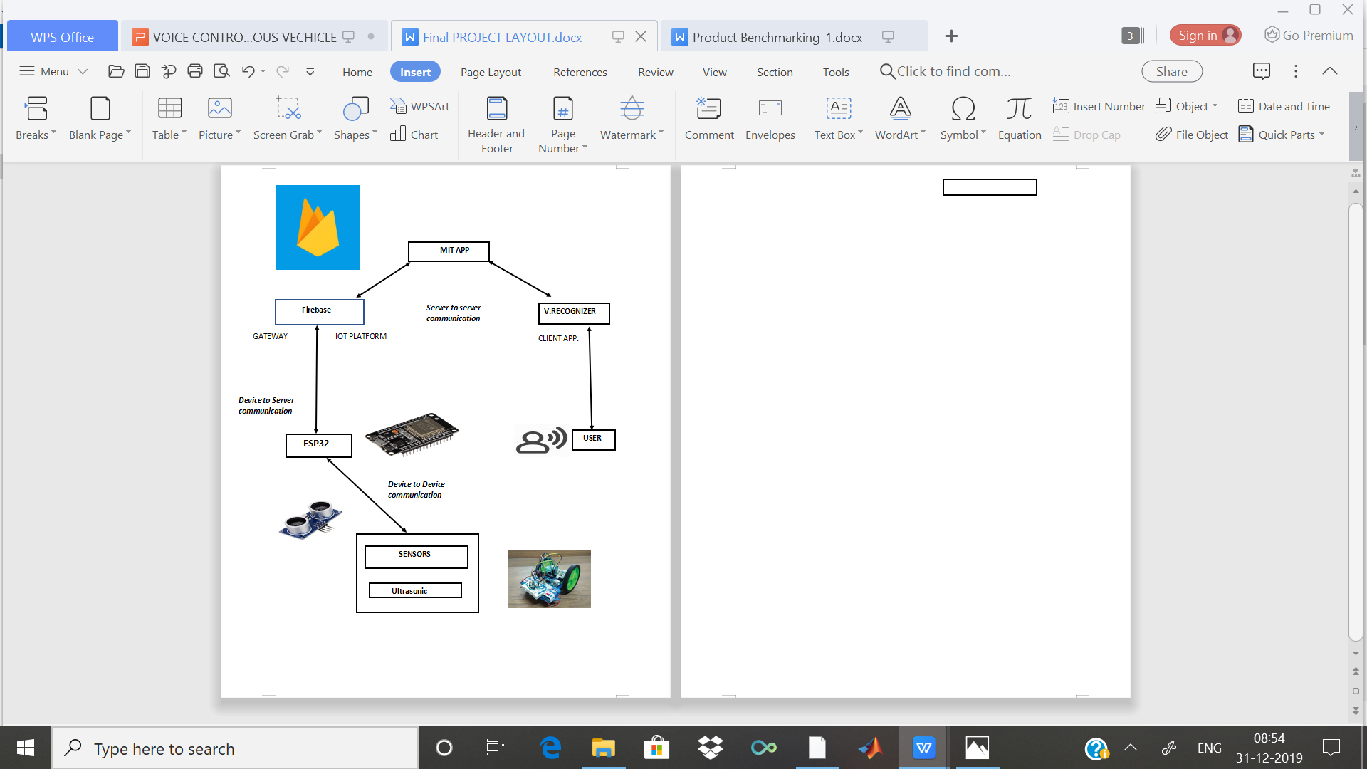
PRODUCT LAYOUT

Slide 7
SWOT ANALYSIS
STRENGTHS:- Road accidents can be reduced by placing the ultrasonic sensor in this type of cars
WEAKNESS:-When there is any small obstacle in front of car then it stops
automatically and internet connectivity.
OPPORTUNITIES:-Works on voice command and provide comfortable driving facility.
THREATS:-The voice command fails when a wrong command is given and this
may lead to accidents

Slide 8
APPLICATIONS
The robot is useful in places where humans find difficult to reach but human voice reaches .E.g. in a small pipeline , in a fire-situations ,in highly toxic area
Command and control of appliances and equipment.
This car can be used as the vehicle for the disable persons like people who don’t have limbs

Slide 9
FUTURE SCOPE
This research work has been narrowed down to short range ZigBee module. Using a long range modules will result in connectivity with the robot for long distances.
Power Optimization such sleep and wakeup schedules can be incorporated.
Image processing can be implemented in the robot to detect the color and the objects.
Automatic Targeting System can be implemented in the robot for tracking the
target.

Slide 10
CONCLUSION
IoT is the evergrowing feild .Use of robots and automation drastically improves the productivity and help to reduce resource wastage.
The voice recognition software has an accuracy around 75% in correctly identifying a voice command.
But it is highly sensitive to the surrounding noises. There is a possibility of
misinterpreting some noises as one of the voice commands given to the robot.
Also the accuracy of word recognition reduces in face of the noise. The sound coming from motors has a significant effect on accuracy.
In these model we have added ultra sonic sensor for stopping the vehicle orif any obstacle comes

Slide 11
REFERENCES
www.esp32.org
www.beyondlogic.org
www.wikipedia.org
www.elementzonline.com
www.elementztechblog.wordpress.com

Slide 12
THANKING YOU
Submitted by: Naga Prem Sai Nellure
Sanket Mallawat
Shiven Desai
Ishita Kundu
Supriya Mane

